Slide 1
Prehospital sepsis care
Sepsis Identification
Overview
Jason Walchok FP-C
Training Coordinator
Greenville County EMS

Slide 2
Objectives
Describe the pathophysiology of Sepsis
Define Sepsis, Severe Sepsis, and Septic shock
Describe systemic inflammatory response syndrome (SIRS)
List the common sources of infection presented to EMS
List the “core” treatments for severe sepsis
Describe the importance of early and aggressive treatment of sepsis
Describe the importance of early identification of sepsis

Slide 3
Sepsis
Comes form the Greek “make rotten”
Broadly defined as an infection in addition to systemic inflammatory response.
Typically seen in older adults and those with immune compromise
Mortality can be >50%

Slide 4
The Burden of Sepsis
Severe sepsis and septic shock combined are the 10th leading cause of death in the United States
Over 750,000 cases each year
Two-thirds initially seen in the ED
215,000 deaths annually
50.37 deaths per 100,000 people
Number one leading cause of death in non-cardiac ICU’s
Melamed et al. Critical Care; 2009
Band et al. Academic Emer Med; 2011
Kaukonen et al. NEJM; 2015

Slide 5
Definitions
Systemic inflammatory response syndrome (SIRS)
A clinical response to a non-specific insult of either infectious or non-infectious origin. Defined as 2 or more of the following:
Fever (>101 F) or Hypothermia (<96.8 F)
Heart rate (>90 bpm)
Respiratory rate (>20 bpm or mechanical ventilations)
Signs of poor perfusion (SBP <90 mm/Hg)

Slide 6
Definitions
Sepsis – Systemic inflammatory response to an infection
SIRS criteria X2 and source of infection
Severe sepsis – Sepsis with organ failure
Sepsis with lactate > 2.2 mmol
Septic Shock – Severe sepsis with refractory hypotension
Severe sepsis with SBP <90 mm/Hg after aggressive fluid resuscitation
Lactate is a measure of tissue perfusion regardless of B/P
Decreased oxygenation causes anaerobic metabolism
lactate and hydrogen ions are produced

Slide 7
SIRS
The presence of SIRS does not equal sepsis
Also seen in burns, trauma, surgery, autoimmune disorders, or physical exertion.
Must identify SIRS and a known or suspected source of infection to be classified as septic.
SIRS
INFECTION
SEPSIS

Slide 8
Mortality
Sepsis is the number one cause of mortality in hospitalized patients
Hypotension + Lactic acidosis >4 = 46.1%
Hypotension alone = 36.7%
Lactic Acidosis >4 alone = 30.0%
Compared to
STEMI 30-day mortality rate = 2.5-10%
No one questions why we treat STEMI patients aggressively

Slide 9
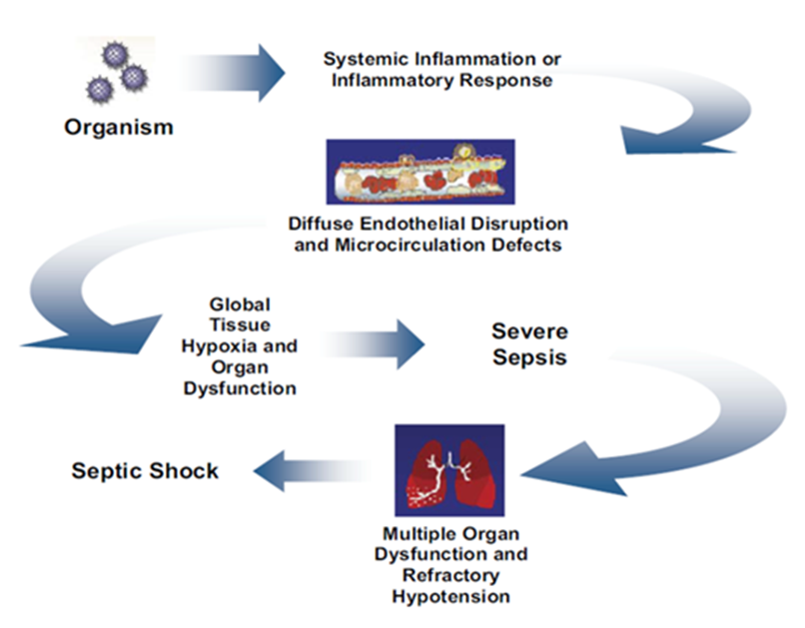
Pathophysiology of Sepsis
Capillaries become increasingly inflamed and porous
Fluids shift causing hypotension and interstitial edema
Pathogens move from the blood into the interstitial spaces spreading infection
Systemic vasculature becomes dilated
Damaged result in platelet aggregation and clotting cascade
Organs “clog up” resulting in reduced organ perfusion (hypoxia)
Disseminated Intra vascular Coagulation (DIC) begins

Slide 10
Inflammatory Cascade
Tissue injury or pathogen causes stimulation of monocytes to produce regulators.
The result is local vasodilation, release of various cytotoxic chemicals and hopefully destroy the invading pathogen.
Unfortunately in a small subgroup of pts there is an excessive amount of “friendly fire” and damage to the pt tissue. mostly the vasculature, so most of the damage is the capillary lining.
This is like killing a cockroach with a hand grenade

Slide 11
Inflammatory Cascade
This reaction intern causes:
Vasodilation
Reduced stroke volume
Microcirculatory failure
The infection doesn’t necessarily spread throughout the body, the inflammatory response does.

Slide 12
Stages of Septic Shock
Hyperdynamic state:
display a fever; warm, dry skin; tachycardia and tachypnea; mental status changes; and decreased urine output.
Hypodynamic state:
display either increased or decreased core temperature; cool skin; tachycardia and tachypnea; obtundation; and oliguria.
The goal is to support and increase perfusion to organs.
The number of organs that fail are a strong indicator of mortality in septic shock.
15% vs 80% mortality when more than one organ is affected.

Slide 13
EMS and Sepsis
EMS transports 34% of all patients diagnosed with sepsis, and 60% of all severe sepsis patients arriving to the ED¹
Arrival by EMS was is associated with decreased time to IVF and antibiotics²
If sepsis is identified by EMS personnel, the reduction in time to antibiotics initiation is substantial (69 vs 131 minutes)³
EMS “Sepsis Alert”: severe sepsis mortality significantly decreased (13.6% vs 26.7%)⁴
¹Wang et al. Resus.; 2012
²Band et al. Academic Emer. Med 2011
³Studak et al. AJEM; 2010
⁴Guerra et al. Journal of EM; 2013

Slide 14
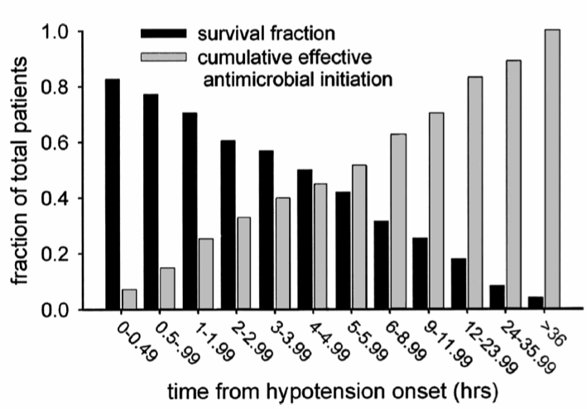
Time to antibiotics
2012 Surviving Sepsis Guidelines
Within one hour of identification
For every hour sooner that antibiotics were delivered decreased mortality by 8% per hour
Antibiotic therapy within the first hour of severe sepsis recognition contributed to 80% survival
Kumar et al. Crit Care Med; 2006
Gaieski et al. Crit Care Med; 2010
Dillinger et al. Intensive Care Med; 2013

Slide 15
Why EMS?
Antibiotics in severe sepsis:
NNT for antibiotics = 1 in 6
NNT for Aspirin in STEMI = 1 in 42
But no one argues the importance of ASA administration in ACS
Median time from triage to antibiotic – 108 minutes
Add 90 min EMS time = 198
Possible 18% reduction in mortality

Slide 16
Prehospital assessment
In most cases EMS providers are in tuned to the presentation of a sick patient needing immediate care.
Identifying patients as sepsis upon arrival at the ED can drastically decrease time to antibiotics and early treatment.
Prehospital identification and treatment of sepsis has the potential to significantly decrease mortality.
Fluid resuscitation
Vasopressors to support end organ perfusion
Early antibiotics

Slide 17
Infection detection
Methodical and thorough history taking can lead you to a majority of infection sources.
SAMPLE, OPQRST, observable signs
Regardless of the point of entry, immunocompromised pts are at the greatest risk.
Organ transplants, aids/hiv, dm, elderly
Most common sources are:
Urinary tract
Respiratory tract
Abdominal
Skin / Device

Slide 18
Infection detection
Hx of recent infection
Recent hospital admission
Including ED and urgent care
Worsening viral-like symptoms
General malaise
Body ache
Decreased appetite
Taking antibiotics
Elderly
Some signs can be masked
Beta blockers, pacemaker
Elderly
Immunosuppressed pts
Referred to as cryptic shock, takes a Phd and many hrs to determine.

Slide 19
Urinary Tract
Foley catheter – long-term 90% develop bacteriuria
Elderly w hx of dm or immunocompromised
Unsanitary conditions
Frequent or hx of UTI, bladder / kidney infections -Rx antibiotics
Symptoms-
Sudden and frequent urges to void
Burning, irritation, or pain while voiding
A feeling of pressure or unable to empty bladder (lower abd, flanks)
Thick, cloudy, foul smelling urine
Nausea / Vomitting
Elderly – sudden change in mentation (confusion, delirium)

Slide 20
Respiratory
Pneumonia (PNA)– cap, hcap, hap, vap
Acquired (community, healthcare, hospital, vent)
Bodies inflammatory response to microbial pathogens.
Normally reside in oral and nasal mucosa
Increased risk
Medical devices such as ett, tracheostomies, ng tubes.
Aspiration, altered LOC
COPD, asthma
Smoking
Suppressed immune system

Slide 21
Respiratory
Symptoms
Progressive onset
Fever, sweating and shaking chills
Hypothermia is noted in older pts and pts with poor over all health
Productive cough (green, yellow, brown) thick and sticky
Chest pain when breathing deeply or coughing
Shortness of breath
Fatigue and muscle ache
Nausea, vomiting, diarrhea
headache

Slide 22
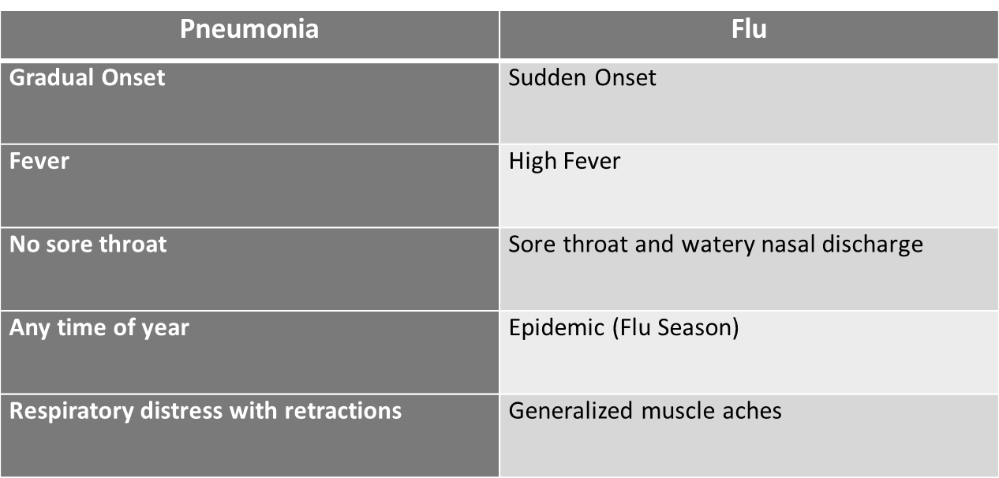
PNA vs Flu

Slide 23
GI / Abdominal
Leading cause is Peritonitis
Bacteria enters the blood stream from an infected organ or ascites
Bowel obstructions – ischemic
Perforations – Ulcers
Abscesses
Diverticulitis
Biliary causes – gallbladder infection or obstruction
Liver disease
PID – ovarian abscess, ovarian cyst

Slide 24
GI / Abdominal
The key is hx, recent and chronic
Pancreatitis, Liver disease, ascites
Symptoms
Abd cramping pain, guarding
Distention
Constipation
Unable to have a bm
n/v/d
Abnormal vomit – bile, fecal matter
Anorexia

Slide 25
Skin / Device
When the integrity of the bodies largest protective system is compromised it increases the risk of infection.
Burns over large areas of the body (graphs)
Penetrating injuries that involve the vasculature
Pressure Ulcers
Surgical sites, wound dressings
Peg tubes
Cellulitis
Peripherally inserted central catheter (Picc), Central Venous Catheter (CVC)

Slide 26
Summary
Early identification is the cornerstone for decreasing mortality
Sepsis must be recognized with SIRS criteria x2 and a known or suspected source of infection.
Hyper-/ Hypothermia (>101 or <96.8 dF)
Respirations >20
Heart rate > 90 bpm
Signs of hypoperfusion (SBP<90mm/Hg)

Slide 27
Summary
A Thorough and methodical assessment can lead an provider to a source of infection in the presences of SIRS.
A known or suspected source of infection with the presentation of SIRS is defined as SEPSIS.

