Slide 1
Prehospital sepsis care
Prehospital treatment
Operations
Jason Walchok FP-C
Training Coordinator
Greenville County EMS

Slide 2
GCEMS Sepsis treatment protocol
Developed in collaboration with the 2 hospital systems in the local area.
Treatment in line with current standard of care for suspected septic patients in hospital.
Process for blood culture collection and appropriate ABX administration.

Slide 3
Objectives
Review the importance of antibiotic administration for serve sepsis and septic shock.
Describe the importance of blood culture collection prior to antibiotic (ABX) administration.
Understand the need for accurate serum lactate collection
List the steps involved in aseptic blood culture collection
Describe the equipment in the “Sepsis Kit”
Outline the proper steps to antibiotic administration

Slide 4
Evaluation and Treatment tool
Half sheet (front and back) on Green cardstock for easy recognition in the ED.
Facilitates quick transfer of septic patients in the ED with all pertinent documentation in one place.
Written and verbal report
ABX administration time
Blood collection time

Slide 5
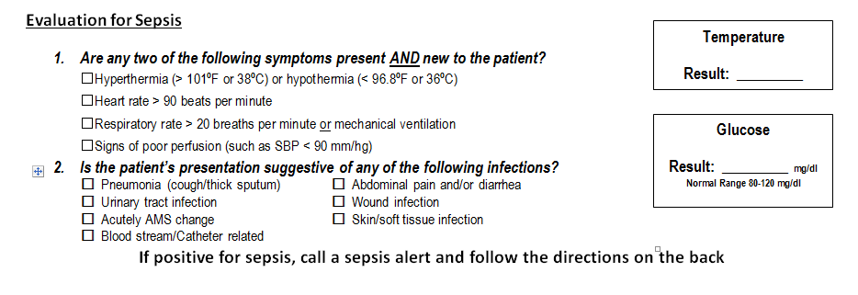
Evaluation tool
A quick guide for providers during assessment and treatment of a suspected septic patient.
SIRS criteria
Common sources of infection

Slide 6
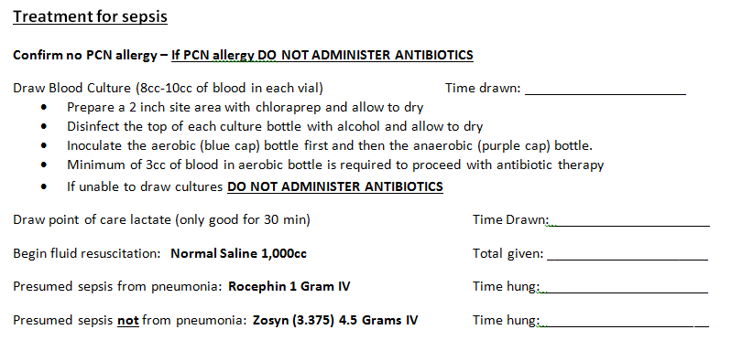
Treatment tool
Outlines the procedure and treatment methodology for a suspected sepsis patient as outlined in the GCEMS protocol.
Blood collection
Fluid administration
ABX administration

Slide 7
GCEMS Sepsis treatment steps
Initial assessment and full set of vital signs (including temperature)
Identify suspected septic patient through assessment
SIRS x2 and known or suspected source of infection
IV access utilizing Chloroprep
Draw blood cultures
Draw blood for lactate measurement
Fluid bolus (1000ml NS)
Administer appropriate antibiotic (ABX) IV
Activate “Sepsis Alert”

Slide 8
GCEMS Training Video
Your equipment and steps may vary depending on your transport destination
This should be used as an example of the GCEMS process for blood collection

Slide 9
Blood culture collection
Blood cultures are used to detect the presence of bacteria or fungi in the blood, to identify the type present, and to guide treatment.
Collecting blood cultures prior to antibiotic administration offers the best hope of identifying the organism that caused severe sepsis in an individual patient.
This procedure is highly scrutinized in hospital to maintain a low contamination rate.
Contamination is the presence of an organism in the culture that is not present in the blood. (poor aseptic technique)

Slide 10
EMS blood culture collection
EMS must beheld to the same standards as the ED for collection.
Contamination rate <6%
One procedure for all providers to ensure consistency
Developed in collaboration with receiving hospital systems.
Your cultures will become their cultures once processed in their lab, hospital labs must maintain a low contamination rate.

Slide 11
Collection steps
Maintain aseptic technique
Clean gloves
Clean area
Scrub the site (AC preferred) with Chloroprep applicator for 30-60 seconds
2 inches around the site
Allow Chloroprep to dry…. On its own
“Drying time is dying time”

Slide 12
Collection steps
Remove caps and clean culture bottles with alcohol
Venipuncture with selected catheter
Do not touch clean site prior to insertion
Connect vacutainer to the hub of catheter
Fill each blood culture bottle with 5-10 ml blood:
Aerobic (Blue/Grey) first
Anaerobic (Purple) second
If only enough blood is collected for one culture, the Aerobic bottle must be filled before antibiotic administration can be considered.

Slide 13
Lactate Collection
When oxygen delivery to organs decreases (hypo perfusion) lactate acid is created due to anaerobic metabolism.
This is an indication of organ dysfunction (Severe Sepsis)
If point of care lactate machines are not available, blood for lacate analysis at the ED must be collect by paramedics prior to fluid resuscitation.
It is vital that the initial serum lactate level is known during treatment in hospital.

Slide 14
Lactate Collection
Either a heparinized blood tube or Grey top blood tube may be used for lactate collection.
Serum lactate in heparinized blood will only last 20 minutes but can be processed immediately in the ED via and ABG machine.
Serum lactate in a grey top tube will last 2 hours but will take approx 1 hour to process in the ED laboratory.
Regardless, the initial serum lactate level gives vital information to the receiving physician and critical care team prior to further resuscitation of the patient.

Slide 15
GCEMS Sepsis Kit
Includes:
Blood cultures (set)
Blood tubes (Grey and Green)
Chloroprep x 2
Alcohol preps x 2
Wrist band
Sepsis assessment and treatment sheet
Antibiotics and mini-bag

Slide 16
GCEMS antibiotics
PCN allergy – No ABX (ask specifically)
At least 5cc of blood in the Blue top Culture bottle (Aerobic)
No Cultures = No ABX
2 SIRS Criteria and known or suspected source of infection.
“Sepsis Alert”
Administer over 30mins
Administer regardless if a patient is on oral antibiotics.

Slide 17
Antibiotics
Rocephin (Ceftriaxone)
- 1 Gram
Used in suspected or documented pneumonia only
3rd generation Cephalosporin, broad spectrum activity against gram positive and gram negative pathogens
Inhibits cell wall synthesis

Slide 18
Antibiotics
Zosyn (Piperacillin/Tazobactam )
– 4.5 Grams (OR 3.37 Grams)
Combination antibiotic
Piperacillin – extended-spectrum penicillin antibiotic
Tazobactam – b-lactamase inhibitor
Activity against many gram-positive and gram-negative pathogens
Side effect: Relatively safe with no pcn(-cillin) allergies, diarrhea most common.
Indication: All sources of infections other than pneumonia

Slide 19
Mini Bag Plus System
Baxter Mini-bag +
50cc NS with vial attachment
Diluent bag with integrated adapter creates an admixture system
Compatible with standard 20 mm closure, single-dose, powdered-drug vials
Can be activated at point of care using proper aseptic technique
No exposed spike or needles
Can be docked outside the pharmacy using proper aseptic technique

Slide 20
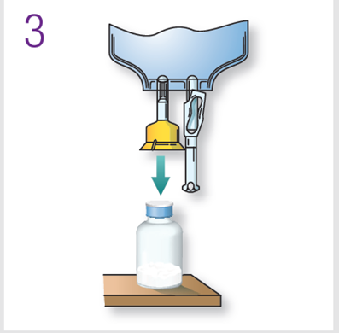
Mini-Bag Plus System
Assembly
1. Remove vial cover
Disinfect stopper
2. Peel off foil cover
Inspect adaptor for moisture
Discard if found
3. Place vial upright
Hold firmly
Push adaptor down until vial snaps in place
DO NOT TWIST
Pull vial to ensure fully seated

Slide 21
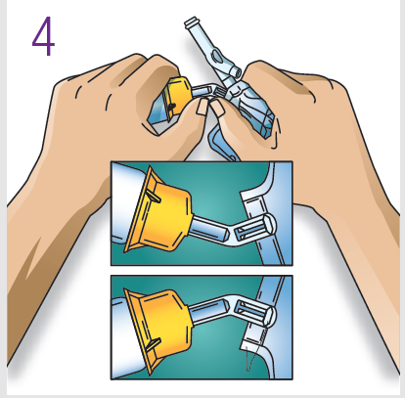
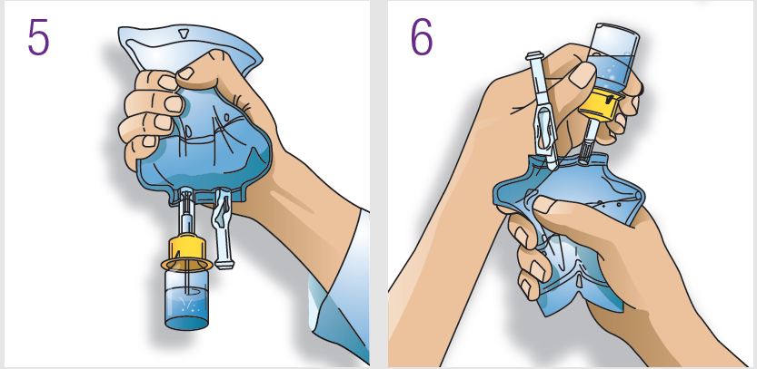
Mini-Bag Plus System
Reconstitution
4. Squeeze bag and check vial
Use only if vial fully seated and dry
Bend up then down to break seal
5. Hold bag with vial down
Squeeze solution into vial until half full
Shake to suspend drug in solution
6. Hold bag with vial upside down
Squeeze bag to force air into vial
Release to drain suspended drug from vial
Repeat steps 5 and 6 until vial is empty of drug and solution is thoroughly mixed. Ensure drug is completely dissolved. Do Not Remove Drug Vial.

Slide 22
Mini-Bag Plus System
Remove port protector.
Attach administration set per its directions.
8. Hang container on I.V. pole and prime set per directions.
Ensure that vial is empty of drug and solution. Repeat step 6 if drug and solution remain in vial.
9. Document the time on green sheet and PCR

Slide 23
Fluid Resuscitation
30ml/kg initial bolus
1liter followed by a second during extended transports
Observe for signs of fluid overload
Pulmonary Edema
Consider Dopamine 2-20mcg/kg/min
After fluid administration and SBP <90mmHg (Septic Shock)

Slide 24
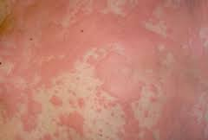
Reactions
Administration of IV antibiotics does carry the risk of allergic reactions
Be prepared to intervene and immediately stop antibiotic administration of signs of an allergic reaction are observed.
Signs and symptoms of reaction:
Skin rash
Hives
Itching
Fever
Swelling
Shortness of breath
Wheezing
Runny nose
Itchy, watery eyes
Anaphylaxis

Slide 25
Data collection
Once the patient is delivered to the ED the Evaluation and treatment tool is filled out and left with the ED staff.
A copy of the form is set to the training department for QA and data collection.
ePCR # and crew is collected
This is compared to contamination records at the ED for identification of providers with deficiencies.

Slide 26
QA/QI
100% QA on all Sepsis alerts
Demonstrate the reliability of your assessment tool
Compare Sepsis alerts to in-hospital ICD-9 diagnosis
Appropriateness of treatment
Provider collecting blood cultures
In-hospital blood lactate levels

Slide 27
Thank You
Jason Walchok, NRP, FP-C
Greenville County EMS
Training Coordinator
P: 864-467-7389
jwalchok@greenvillecounty.org

